Slide 1
Wellesley College
Class of 2003
20th Reunion Digital Memory Book

Slide 2
Hello! What is this?
For our 20th Wellesley Reunion we are doing a digital record book. We will send out the complete “book” as a pdf.
Please take a look and pick a slide template that you like - or even make up a whole new slide that suits your vibe. You’ll notice that there are different examples of slides in this deck. Some are more finished and others have a real paint-by-number vibe.
Save a local copy for you to edit.
You can make 1 slide or more if you want to.
Once your slide/s are ready, you can upload them to our google form or email them to Wellesley2003Reunion@gmail.com

Slide 3
FAQs
Q. Do I have to use google slides?
No, you can use any program you want to create your book page or pages. Upload your slide(s) to our google form or send a pdf of your page/s to Wellesley2003Reunion@gmail.com
Q. What’s the smallest font size I can use?
These pages will likely be viewed digitally so people will be able to zoom in a bit. Even so, we didn’t go smaller than a 10 point font in the templates - folks may print them out and some of us are already wearing reading glasses.
Q. What’s the due date?
Send in your page/s by April 25th
Q. I have more questions!! To whom should I address them?????
Send April Randall and Morgan Munro (reunion co-chairs) your questions via Wellesley2003Reunion@gmail.com

Slide 4
Slide Templates
You can send in multiple slides or one!
Use any of these or make up your own :)
Different slide templates have different vibes - check them out and see if any of them work for you. You can edit anything or make up a slide - whatever works for you!

Slide 5
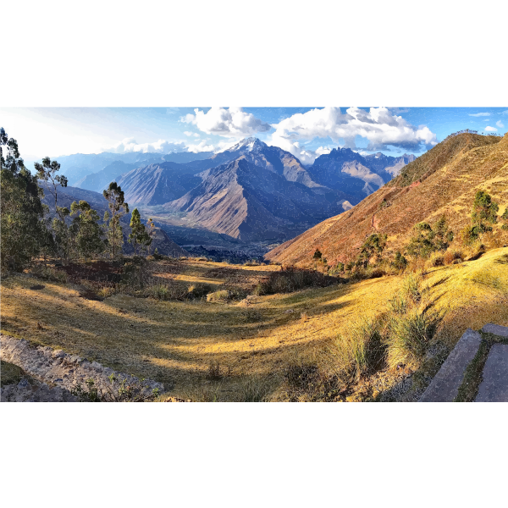
Student Name at Wellesley & Current Name
My family: My wonderful nieces Zelda and Peach
The beach is my happy place these days!
Name at Wellesley, Current
Address
City, State, County
Postal Code
Email
Phone Number
Social Media accounts
I started baking in the pandemic and haven’t stopped!
Work Info: Role/Title
Employer
How would you explain what you do to a child?
Heavy Rotation: I’ve been playing this album for 20 years!
Volunteer work:
My next adventure is a trip to Peru in 2025!
I’ve loved watching the White Lotus!
Notes:
Q. Who are these people on the slides and why don’t you recognize them?
Because they are made up! Don’t worry! You shouldn’t know who they are. ;)

Slide 6
Student Name at Wellesley & Current Name
My family: Add your photo and caption here
Where’s your happy place?
Name at Wellesley, Current
Address
City, State, County
Postal Code
Email
Phone Number
Social Media accounts
Your hobbies
Work Info: Role/Title
Employer
How would you explain what you do to a child?
Heavy Rotation: What have you been listening to lately?
Volunteer work:
What’s your next adventure?
What have you been reading or watching?

Slide 7
Student Name at Wellesley & Current Name
At work: I own a custom divorce cakes bakery and business has been amazing!
At ??????: Insert copy here
Name at Wellesley, Current
Themed photo here.
Address
City, State, County
Postal Code
Email
Phone Number
Social Media accounts
Work Info: Role/Title
Employer
How would you explain what you do to a child?
Volunteer work:
At play: I go on an overseas trip twice a year! Next up: Morocco and South Korea!
At rest: I have fallen in love with hiking and it recharges me every time!

Slide 8
Student Name at Wellesley & Current Name
At work: add a photo and a caption here
In community: add a photo and a caption here
Name at Wellesley, Current
Themed photo here.
Themed photo here.
Address
City, State, County
Postal Code
Email
Phone Number
Social Media accounts
Pssst… Use this to get started but make it yours - change anything you’d like!
Work Info: Role/Title
Employer
How would you explain what you do to a child?
Themed photo here.
Themed photo here.
Volunteer work:
At play: add a photo and a caption here
At rest: add a photo and a caption here

Slide 9
Student Name at Wellesley & Current Name
A photo or short story about something tough you’ve faced
It’s been a long 20 years - share something here about your growth or how you’ve changed
Name at Wellesley, Current
Address
City, State, County
Postal Code
Email
Phone Number
Social Media accounts
“A quote that inspires or sustains you”
Work Info: Role/Title
Employer
How would you explain what you do to a child?
Share about a time when you stepped back or recalibrated
Share about how your sense of purpose and/or accomplishment has shifted over time
Volunteer work:

Slide 10
I started baking in the pandemic and haven’t stopped!
My family: My wonderful nieces Zelda and Peach
I’ve loved watching the White Lotus!
The beach is my happy place these days!
My next adventure is a trip to Peru in 2025!
Name at Wellesley, Current
Work Info: Role/Title
Employer
How would you explain what you do to a child?
Volunteer work:
Address
City, State, County
Postal Code
Email
Phone
Social Media

Slide 11
Add a photo and a caption about your hobbies here
Add a photo and a caption about you and your people here
Add a photo and a caption about what you’ve been reading or watching here
Add any photos or captions that you want to! These are suggestions to get you started
Add a photo and a caption about your happy place here
Add a photo and caption about your next adventure here
Name at Wellesley, Current
Work Info: Role/Title
Employer
How would you explain what you do to a child?
Volunteer work:
Address
City, State, County
Postal Code
Email
Phone
Social Media

Slide 12
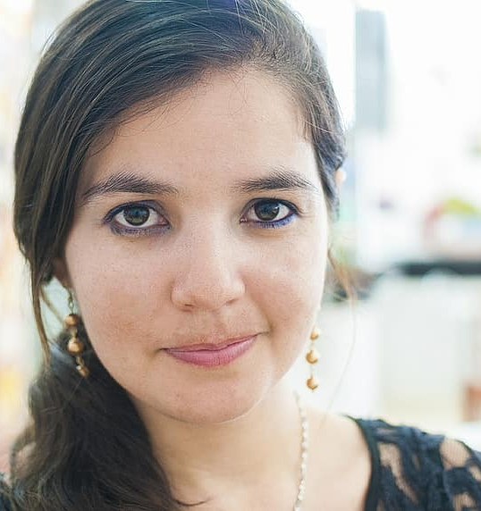
2003 2008 2013 2018 2023 …2028
2008: I moved to NYC
2009: Started business school at NYU
2021: Closed my shop and became a digital nomad
2028: I have no idea! Probably still helping others. I would love to be doing more stand up by then!
2014: Moved to Chicago
2017: Started my own coffee shop!
2004: I moved to Portland, Or and started working at Coffee, Coffee, Coffee
2012: Went into the Peace Corps
2023: I’m working from the road and being a consultant for other restaurant owners!
2011: Earned my MBA
2015: Started volunteering with my local community theater troupe!
Name at Wellesley, Current
Work Info: Role/Title
Employer
How would you explain what you do to a child?
Address
City, State, County
Postal Code
Volunteer work:
Email
Phone Number
Social Media accounts

Slide 13
2003 2008 2013 2018 2023 …2028
Add a photo here from this time in your life
Add a photo here from this time in your life
Add a photo of you
(and your family if you’d like)
Name at Wellesley, Current
Work Info: Role/Title
Employer
How would you explain what you do to a child?
Address
City, State, County
Postal Code
Volunteer work:
Email
Phone Number
Social Media accounts

Slide 14
Student Name at Wellesley & Current Name
My favorite Wellesley memory is the dessert bar in the dining hall!
If I could have dinner with any person I would choose…
Name at Wellesley, Current
Add your photo of cool person/peoples here.
Address
City, State, County
Postal Code
Email
Phone Number
Social Media accounts
Work Info: Role/Title
Employer
How would you explain what you do to a child?
Volunteer work:
My favorite thing these days is travel! I was just in Italy and am going to South Korea next!
My happy place these days is Peru!

Slide 15
Student Name at Wellesley & Current Name
My favorite Wellesley memory is…
If I could have dinner with any person I would choose…
Name at Wellesley, Current
Add your photo of your favorite Wellesley memory here
Add your photo of cool person/peoples here.
Address
City, State, County
Postal Code
Email
Phone Number
Social Media accounts
Work Info: Role/Title
Employer
How would you explain what you do to a child?
Add your photo of you on a trip or your next destination here
Add your photo of your happy place here!
Volunteer work:
My favorite thing these days is…
My happy place these days …

